Slide 1
CHAPTER 2: Andrea
Tentative title: Temporal and elevational variation in intrinsic water-use efficiency (iWUE) in Ecuadorian Andean forests
Part A: Herbarium Analysis
Part B: Rescued Plots

Slide 2

Chapter 2b
RQ:
How does iWUE change between 20 years same individual (paired simple t-test) and between community at different elevations?
How does iWUE relates to relative growth?. (Quang 2025 – iWUE does not stimulate tree productivity).
H1. Intrinsic water-use efficiency (iWUE) increases over time in response to rising atmospheric CO₂.
H2. Despite increases in iWUE, tree growth may not increase accordingly, suggesting a decoupling between carbon gain and growth (e.g., Laffitte et al.).

Slide 3
From the same dataset:
Leaf traits (SLA, thickness,LNC,LCC) – will send samples for nutrient analysis. So also traits with a 20 year gap.
Dynamics (growth) -> Info will be added for chapter3 .
Pending: Literature review on mountain tree leaf traits, Climatic variables from CHELSA.

Slide 4
Summary until now.
Consistent increase with iWUE with altitude. Related to conservative traits at the top of the mountains.
Apparent increase with time at all elevations with the exception of Oyacachi. At 3500 and 4000 the trees are not showing increases but they are decreasing!
Herbarium collections worked for the analysis! – However they introduced more noise compared to the pulverized samples.
Need to explore the differences between sites Eg. Sumaco vs Guacamayos with similar altitude but different plant communities.
Statistical analysis still needed between the paired samples.

Slide 5
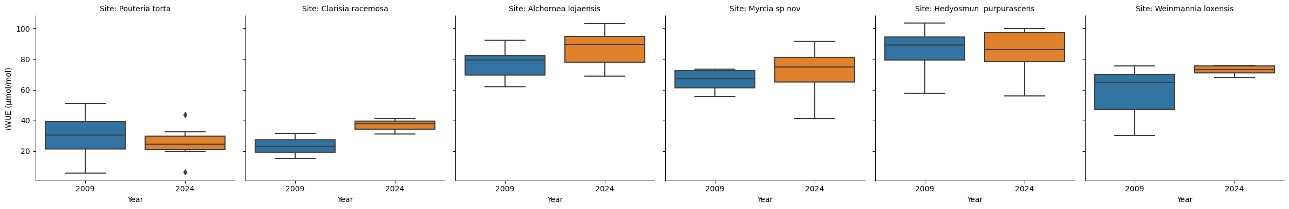
South of Ecuador: Control.
1000
3000
2000
Notes:
Analisis para primer articulo tambien

Slide 6
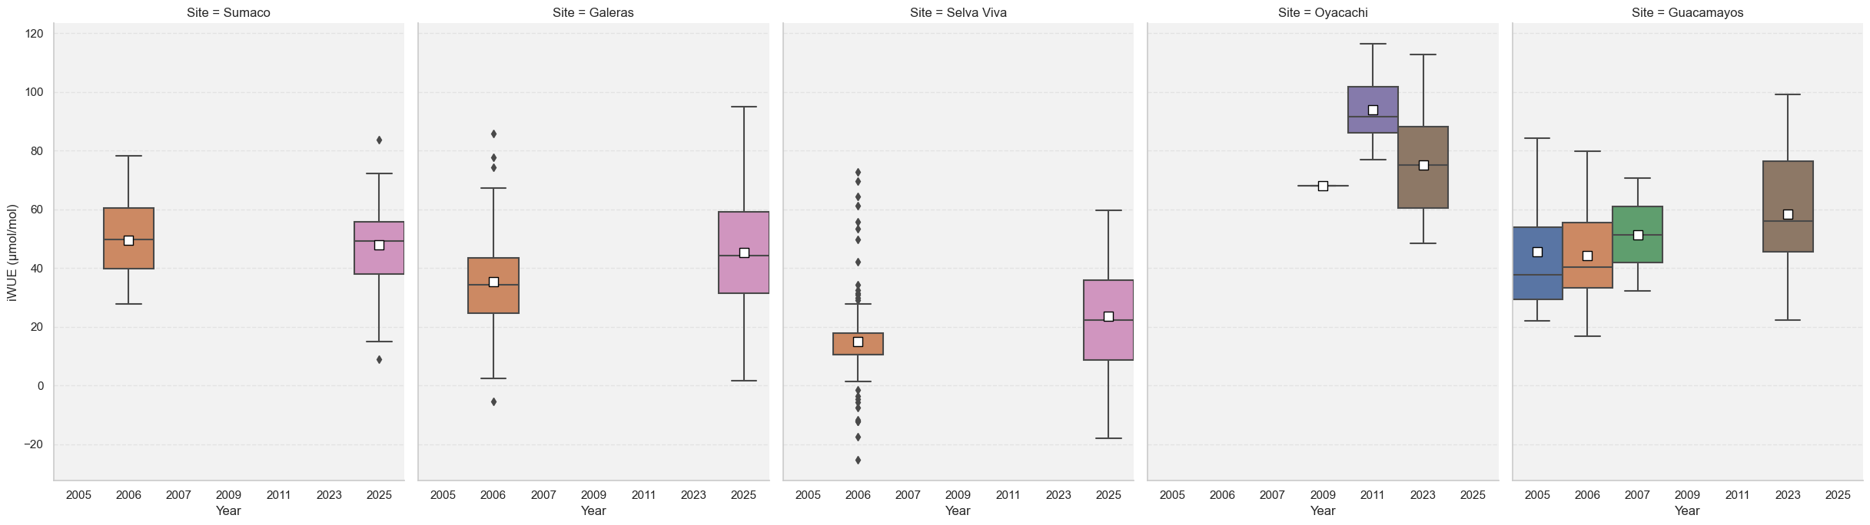
North of Ecuador: Napo results

Slide 7
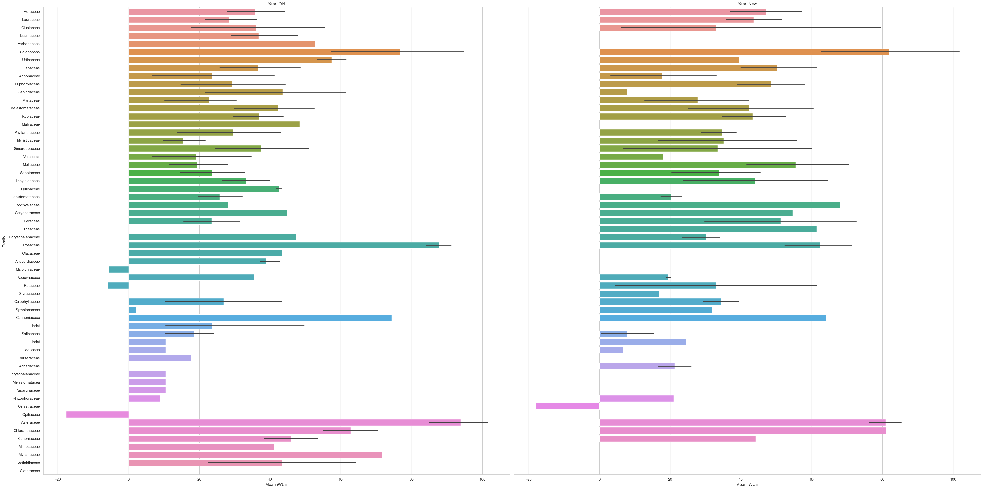
Figure 1. Variation in iWUEs plant families along elevational gradient - NAPO
Notes:
Check how to improve this graphic

Slide 8
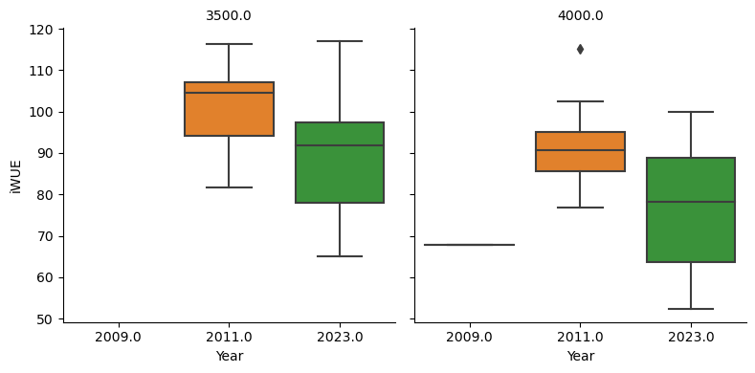
Oyacachi

Slide 9
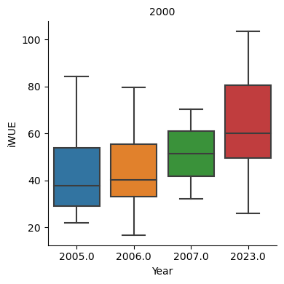
Guacamayos 2000

Slide 10
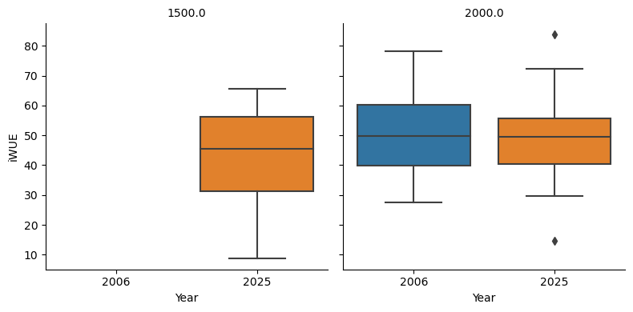
Site: Sumaco 1500 and 2000 m.
Only samples from 2025.

Slide 11
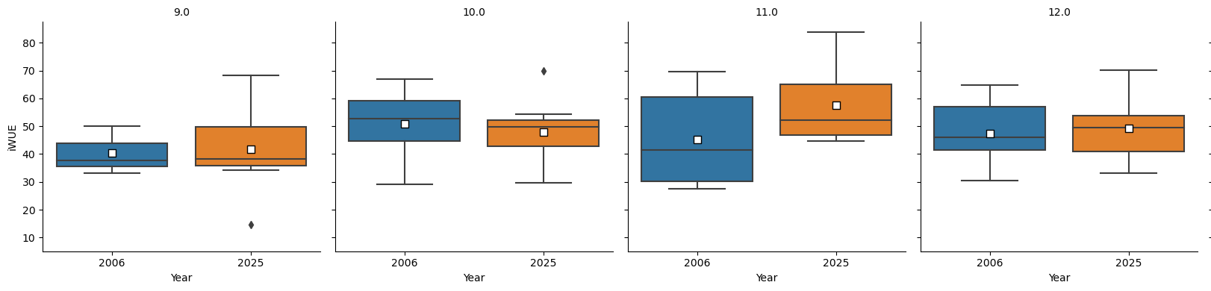

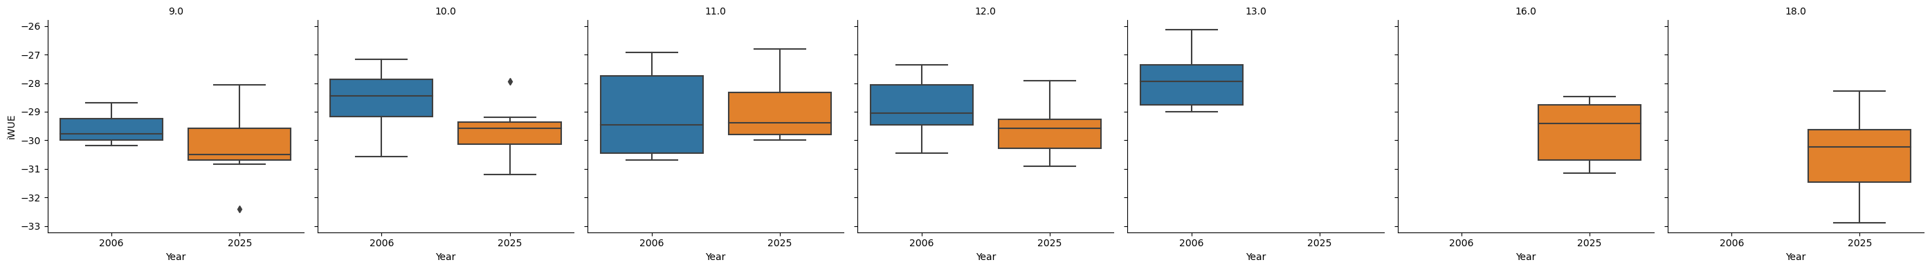
Site: Sumaco 2000
Plot 13, Plot 16 y Plot 18 no data from two time periods – Herbarium?

Slide 12
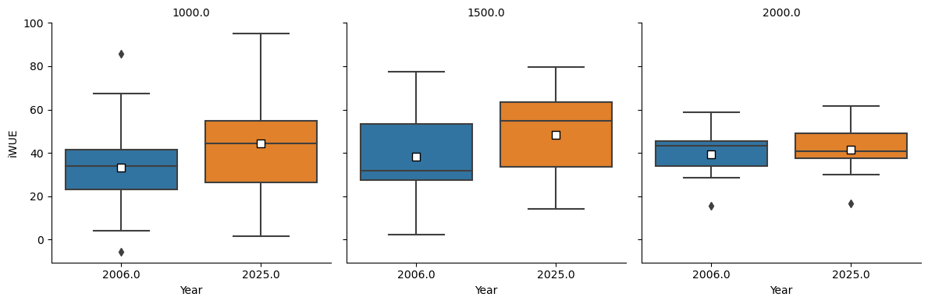
Site: Galeras 1000,1500,2000 m

Slide 13
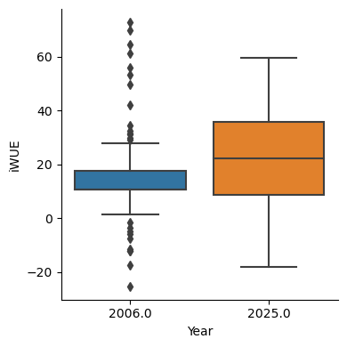
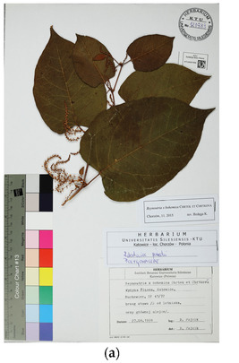
Selva Viva: 500 m

